Slide 1
TRANSPORT RENTING PLATFORM
GROUP: 15
MEMBERS:
MUHAMMED ALFAD
MADHAV

Slide 2
INTRODUCTION
•This project is a web-based platform designed to facilitate peer-to-peer vehicle rentals. Users can list their vehicles for rent, and others can browse and rent them as per their needs. The platform includes role-based access for regular users and an admin to manage listings, users, and transactions.
• The Transport Renting Platform simplify the process of renting vehicles online. With the increasing demand for flexible and on-demand transportation, this platform serves as a bridge between vehicle owners and users who need short-term access to cars, bikes, or autos.
• The system allows users to easily register, browse available vehicles, check rental prices, book vehicles, and manage their bookings—all from a single, easy-to-use interface. Vehicle owners can also list their vehicles, manage availability, and track bookings. The platform supports user authentication, admin controls, and a responsive design to enable easy accessibility .
• This project integrates key concepts of web development, including frontend design, backend scripting, database management, and real-time interaction

Slide 3
MODULES
Staff Management
Customer Management
Category Management
Vehicle Management
Booking Management
Payment Management

Slide 4
1.STAFF MANAGEMENT
The staff role allows personnel to handle incoming requests from customers. They can accept or reject booking requests made by renters, verify the documents provided by renters, and check the authenticity of the vehicle details uploaded to the website.
Add staff
Edit staff
View staff

Slide 5
2.CUSTOMER MANAGEMENT
customers can upload their vehicles to be listed on the platform, while all bookings are made by registered customers through the website.
Register Customer
Edit Customer
View Customer

Slide 6
3.CATEGORY MANAGEMENT
The Category Management module is responsible for organizing all vehicles listed on the platform into predefined categories such as cars, bikes, autos, vans, and more. This helps users easily filter and find the type of vehicle they are looking for
Add Category
Edit Category
View Category

Slide 7
4. VEHICLE MANAGEMENT
This module is used to store and manage detailed information about various vehicles listed on the platform, including type, model, availability, and pricing.
Add vehicle
Edit vehicle
View vehicle

Slide 8
5. BOOKING MANAGEMENT
Through this module, users can view available vehicles, select desired time slots, and complete the booking process. Once a booking is made, the system updates the availability of the selected vehicle to prevent double bookings. Users can also cancel or modify their bookings based on platform policies.
Add booking
Edit booking
View booking

Slide 9
6. PAYMENT MANAGEMENT
The Payment Management module handles all transactions related to vehicle bookings on the platform. It ensures that payments are processed securely, accurately, and efficiently, providing both users and admins with clear records of each transaction
Add payment
Edit payment
View payment

Slide 10
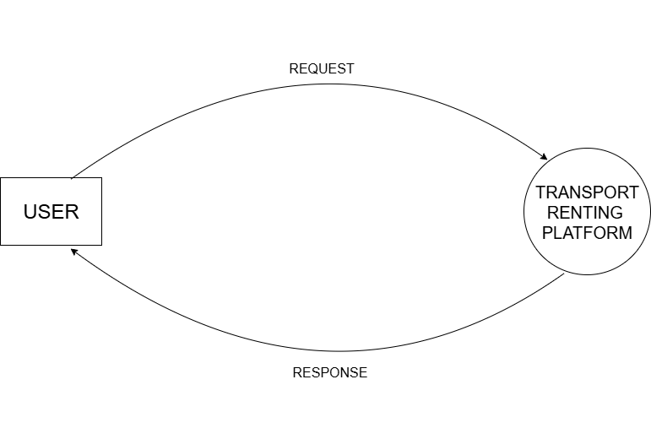
LEVEL 0 DFD SHOWING TRANSPORT RENTING PLATFORM

Slide 11
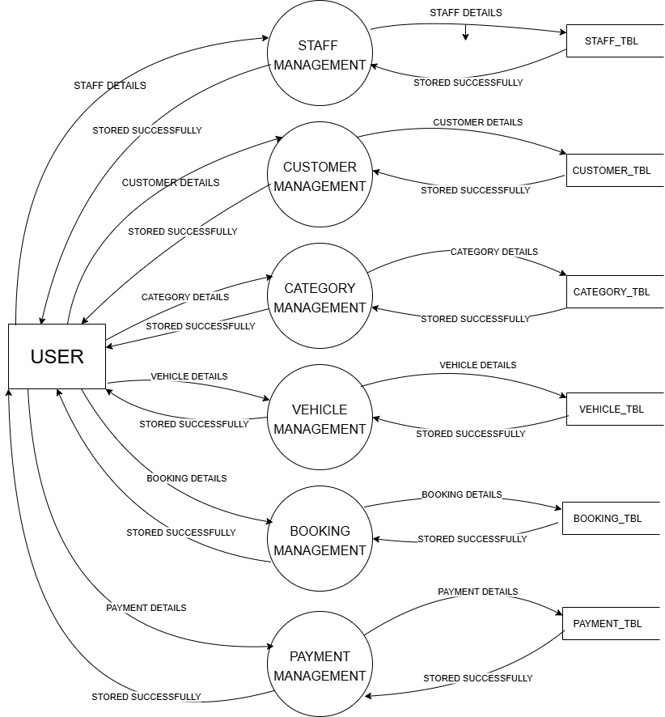
1
2
LEVEL 1 DFD SHOWING TRANSPORT RENTING PLATFORM
3
4
5
6

Slide 12
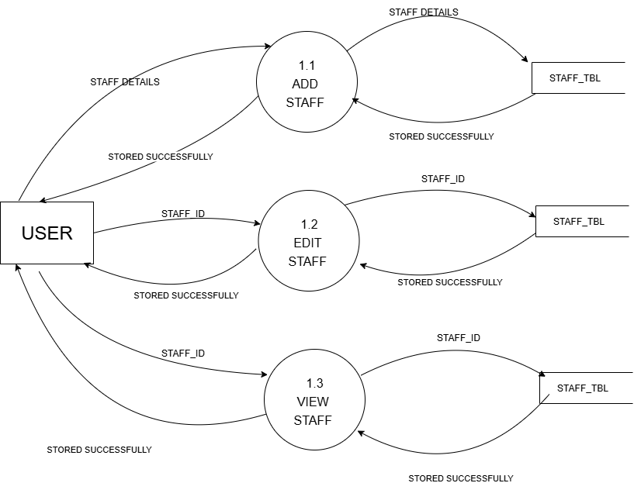
LEVEL 2 DFD SHOWING STAFF MANAGEMENT

Slide 13
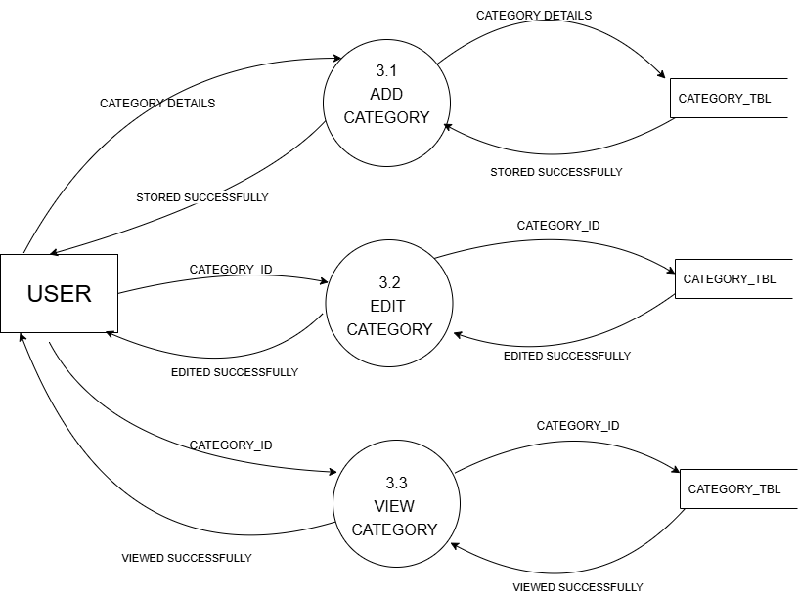
LEVEL 2 DFD SHOWING CATEGORY MANAGEMENT

Slide 14

LEVEL 2 DFD SHOWING VEHICLE MANAGEMENT

Slide 15

LEVEL 2 DFD SHOWING BOOKING MANAGEMENT

Slide 16
LEVEL 2 DFD SHOWING BOOKING MANAGEMENT

Slide 17

LEVEL 2 DFD SHOWING PAYMENT MANAGEMENT

Slide 18
TABLE: STAFF_TBL
Field Name | Data Type | Constraint | Description
staff_id | INT | PRIMARY KEY, AUTO_INCREMENT | Unique ID for staff
st_name | VARCHAR(50) | NOT NULL | Full name of staff member
st_email | VARCHAR(100) | UNIQUE, NOT NULL | Staff login email
st_password | VARCHAR(255) | NOT NULL | Hashed password
st_phone | VARCHAR(15) |  | Contact number
st_address | VARCHAR(150) |  | Address

Slide 19
TABLE: CUSTOMER_TBL
Field Name | Data Type | Constraint | Description
cu_username | VARCHAR(50) | PRIMARY KEY, | Unique Username
cu_name | VARCHAR(50) | NOT NULL | Customer name
cu_Email | VARCHAR(100) | UNIQUE, NOT NULL | Login email
cu_password | VARCHAR(255) | NOT NULL | Hashed password
cu_phone | VARCHAR(15) |  | Contact number
cu_address | VARCHAR(200) |  | Customer address

Slide 20
TABLE: CATEGORY_TBL
Field Name | Data Type | Constraint | Description
category_id | INT | PRIMARY KEY, AUTO_INCREMENT | Unique ID for vehicle category
ca_name | VARCHAR(30) | UNIQUE, NOT NULL | Category name (e.g., Car, Bike)

Slide 21
TABLE: VEHICLE_TBL
Field Name | Data Type | Constraint | Description
vehicle_id | INT | PRIMARY KEY, AUTO_INCREMENT | Unique vehicle ID
customer_id | INT | FOREIGN KEY (customer_id) | Owner of the vehicle
categor_id | INT | FOREIGN KEY | Vehicle category ID
brand | VARCHAR(30) | NOT NULL | Vehicle brand name
model | VARCHAR(30) |  | Vehicle model
reg_number | VARCHAR(20) | UNIQUE | Vehicle registration number
rent_per_day | DECIMAL(10,2) | NOT NULL | Rent price per day
status | VARCHAR(20) | DEFAULT 'available' | Availability status

Slide 22
TABLE: BOOKING_TBL
Field Name | Data Type | Constraint | Description
booking_id | INT | PRIMARY KEY, AUTO_INCREMENT | Unique booking ID
vehicle_id | INT | FOREIGN KEY | Booked vehicle
customer_id | INT | FOREIGN KEY | Customer who booked
start_date | DATE | NOT NULL | Booking start date
end_date | DATE | NOT NULL | Booking end date
bo_status | VARCHAR(20) | DEFAULT 'pending' | Booking status

Slide 23
TABLE: PAYMENT_TBL
Field Name | Data Type | Constraint | Description
payment_id | INT | PRIMARY KEY, AUTO_INCREMENT | Unique payment ID
booking_id | INT | FOREIGN KEY | Associated booking
amount | DECIMAL(10,2) | NOT NULL | Amount paid
payment_date | DATETIME | DEFAULT CURRENT_TIMESTAMP | Date and time of payment
pa_status | VARCHAR(20) | DEFAULT 'paid' | Payment status

Slide 24
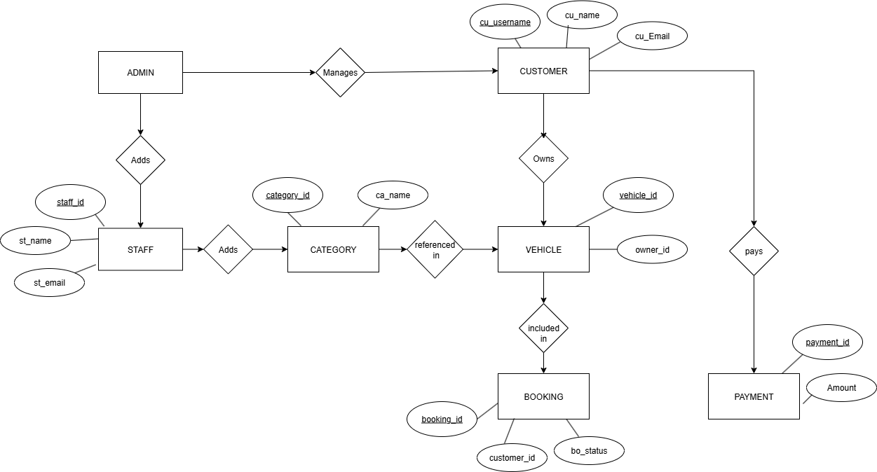
ER DIAGRAM

